Slide 1
VADODARA URBAN DEVELOPMENT AUTHORITY
VUDA
AFFORDABLE HOUSING PROJECT
PREPARED BY
VADODARA URBAN DEVELOPMENT AUTHORITY

Slide 2
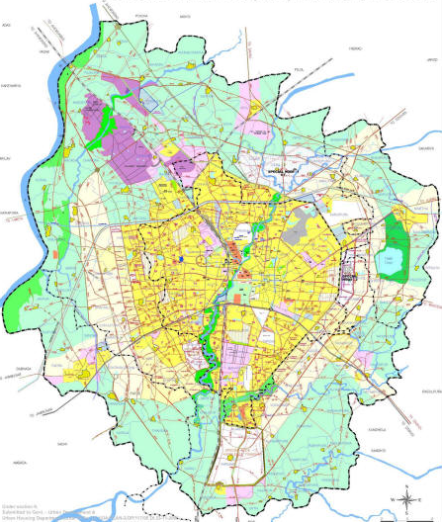
VEMALI_F.P.No. 109 & 119
SEVASI_F.P.No.119
LOCATION MAP OF EWS HOUSING PLOTS

Slide 3
VEMALI_F.P.No. 114
SEVASI_F.P.No.133
LOCATION MAP OF LIG HOUSING PLOTS

Slide 4
Land, Location and Ownership
Package | Location | T.P NO. | FP NO. | Area (in Sq.mt) | Adjoining Road Width (mt.) | Purpose | Land Ownership
Package-1 | Vemali | 1 | 109 | 5224.00 | 18 & 12 | Socially & Economically Weaker Section Housing | Vadodara Urban Development Authority
 | Vemali | 1 | 119 | 2968.00 | 12
 | Vemali | 1 | 114 | 4337.71 | 12
Package-2 | Sewasi | 1 | 119 | 11253.00 | 12
 | Sewasi | 1 | 133 | 3807.96 | 15
 | Total |  |  | 27590.67
LAND, LOCATION & OWNERSHIP

Slide 5
Housing Details (Actual Planned as per Town Planning Rules)
Package | Location | T.P NO. | F.P NO. | Area (in Sq.mt) | Type of Housing | Minimum Carpet area (Sq.mt.) | Total No. of Dwelling Units
Package-1 | Vemali | 1 | 109 | 5224.00 | EWS | 26.13 | 200.00
 | Vemali | 1 | 119 | 2968.00 | EWS | 26.13
 | Vemali | 1 | 114 | 4337.71 | LIG-1 | 36.20 | 80.00
 |  |  |  |  | LIG-2 | 46.85 | 112.00
Package-2 | Sevasi | 1 | 119 | 11253.00 | EWS | 26.13 | 320.00
 | Sevasi | 1 | 133 | 3807.96 | LIG-1 | 36.20 | 60.00
 |  | 1 | 133 |  | LIG-2 | 46.85 | 60.00
 | Total |  |  | 27590.67 |  |  | 832.00
HOUSING DETAILS

Slide 6
E W S
SEVASI

Slide 7
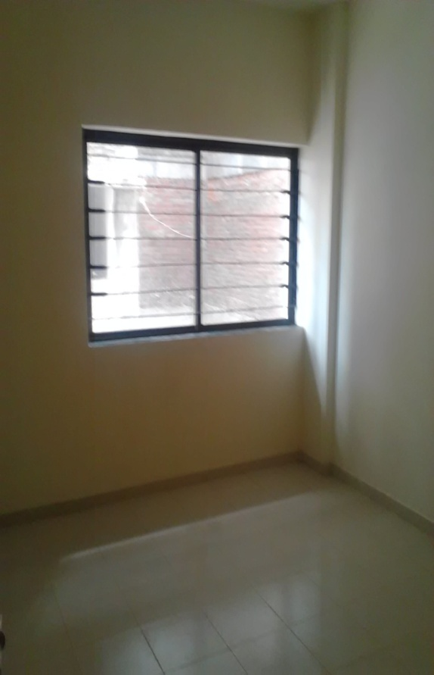
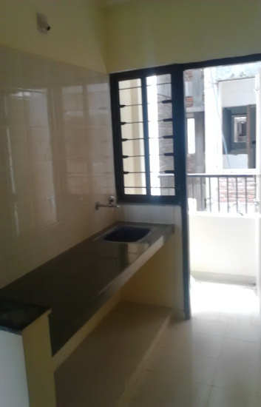
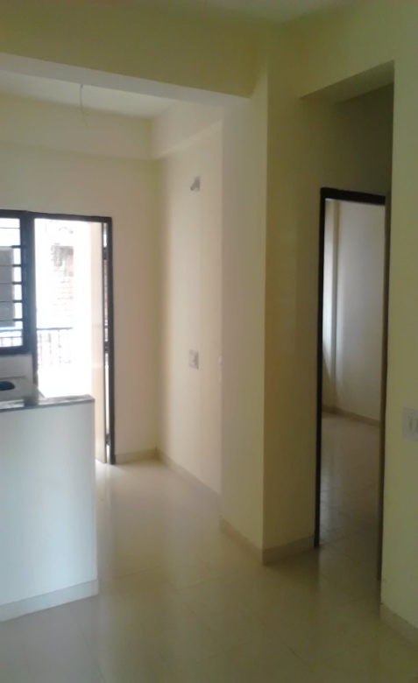
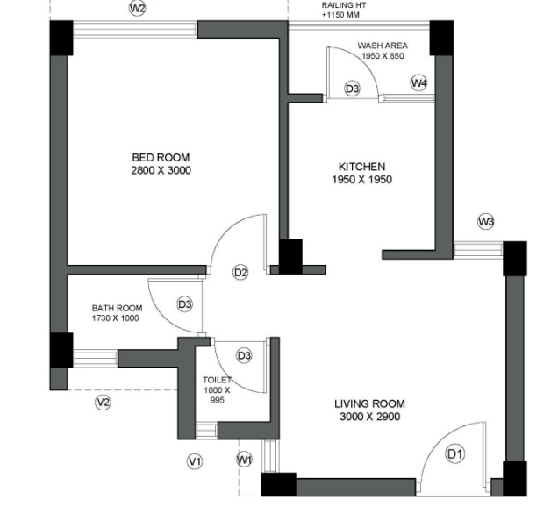
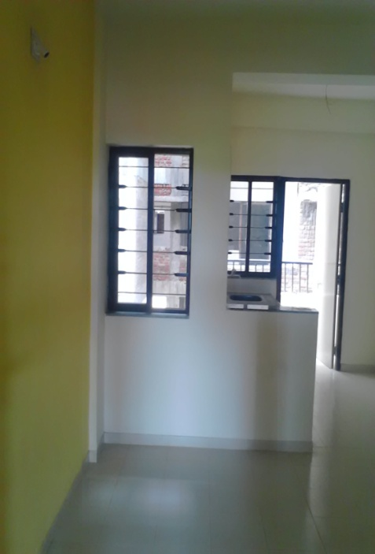
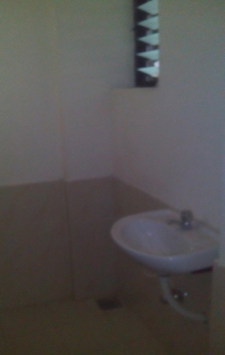
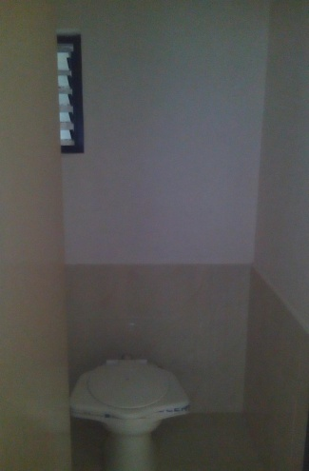
EWS SEVASI
UNIT PLAN & SAMPLE FLAT PHOTOS OF EWS SCHEME

Slide 8
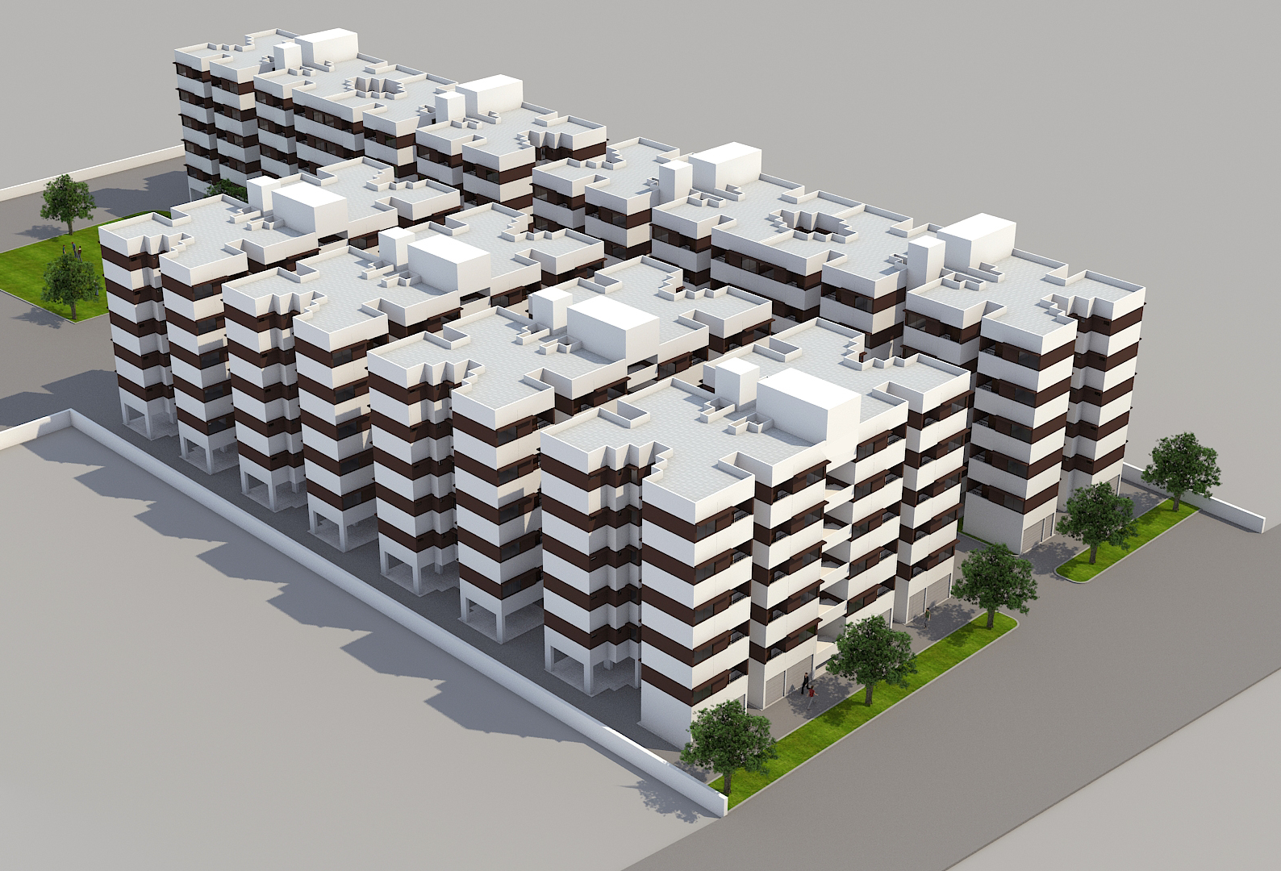

Slide 9
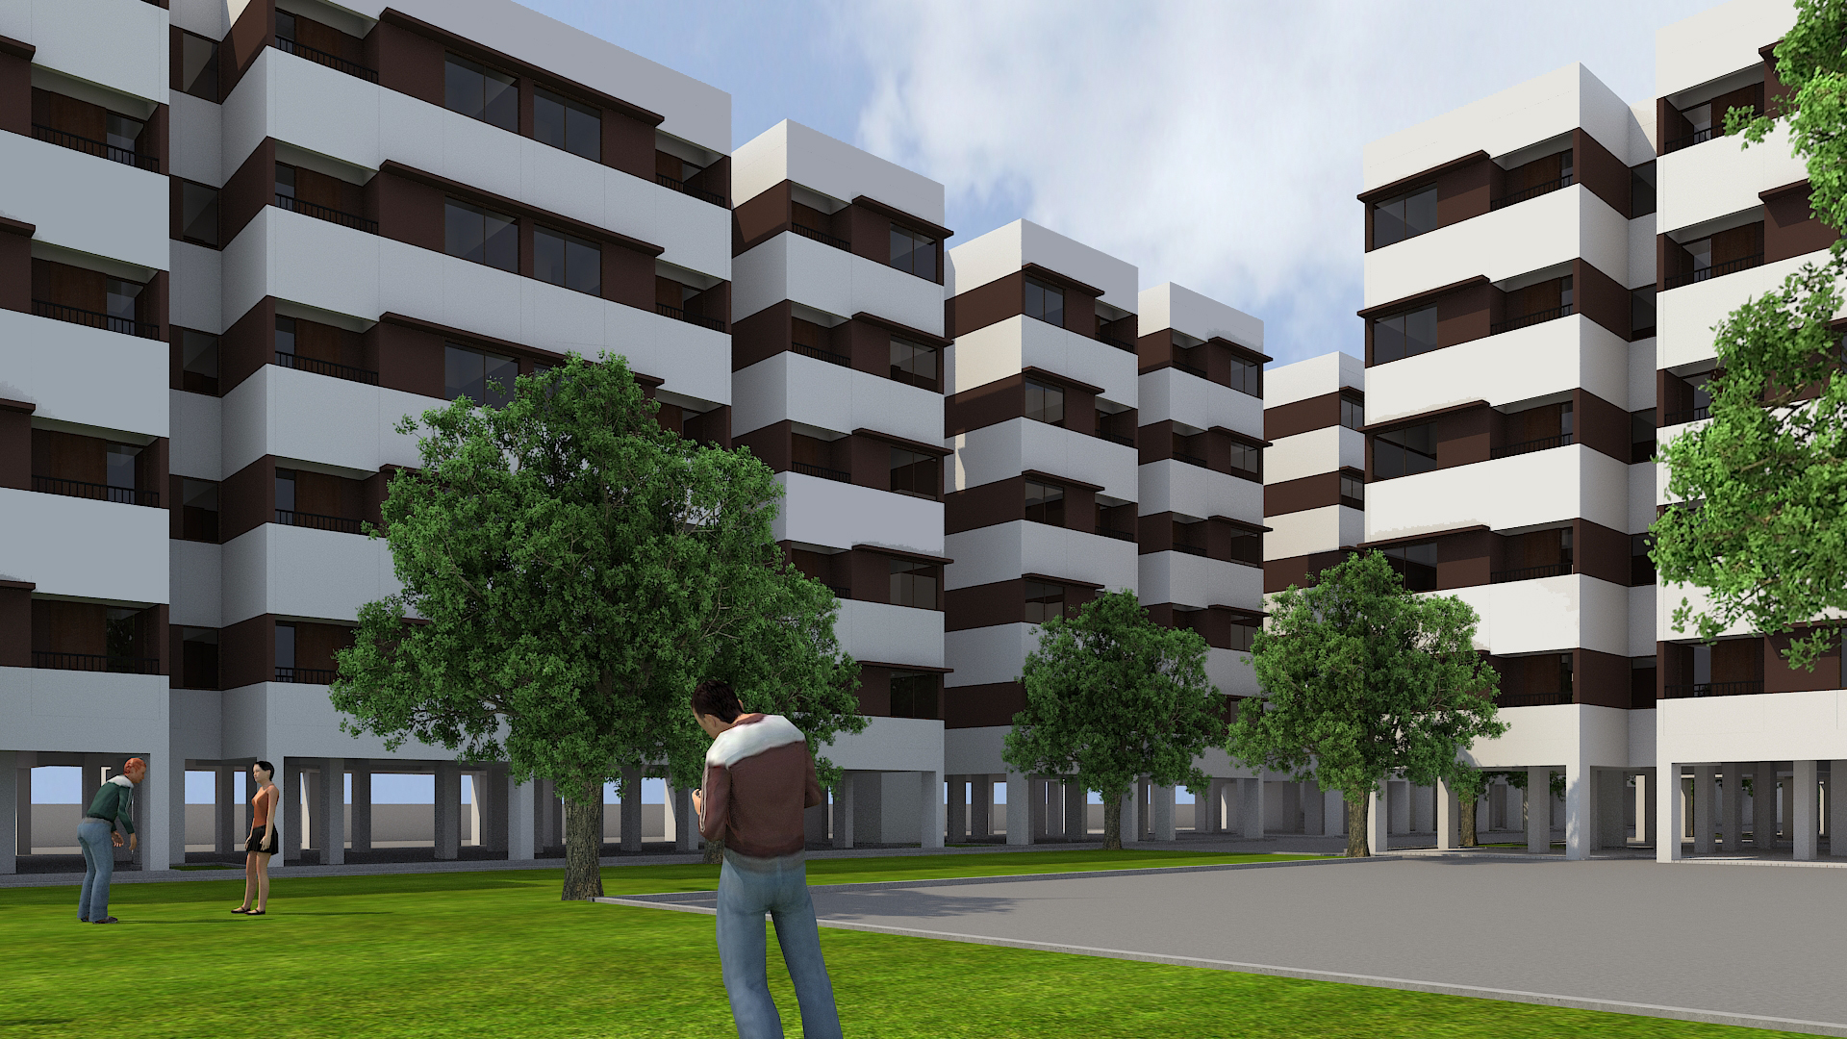
EWS SEVASI
3D VIEWS FOR EWS SCHEME
9

Slide 10
E W S
VEMALI

Slide 11
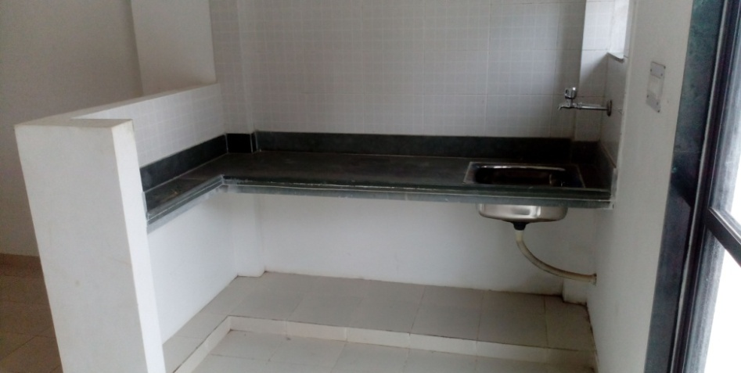
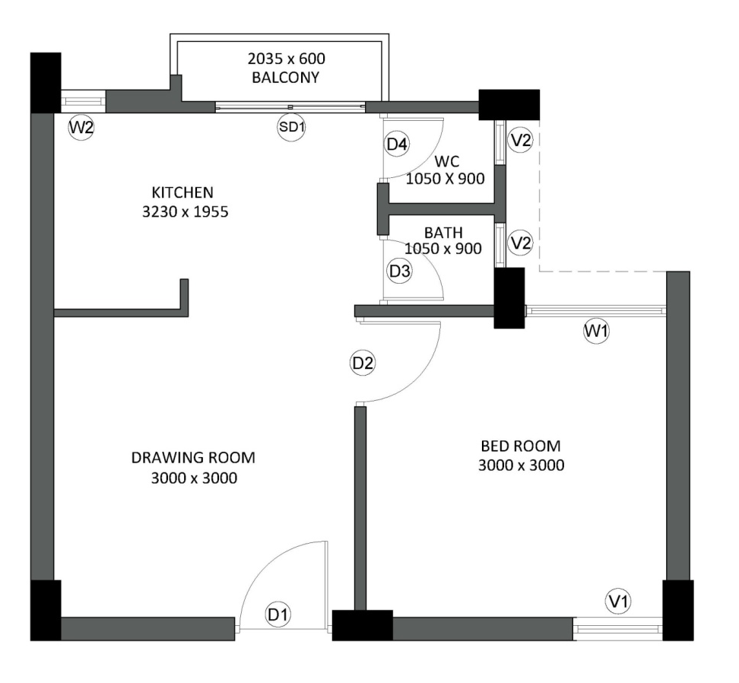
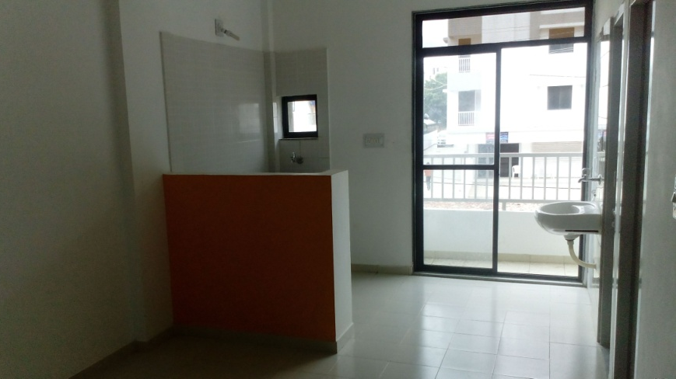
EWS VEMALI
UNIT PLAN & SAMPLE FLAT PHOTOS OF EWS SCHEME

Slide 12
L I G
SEVASI

Slide 13
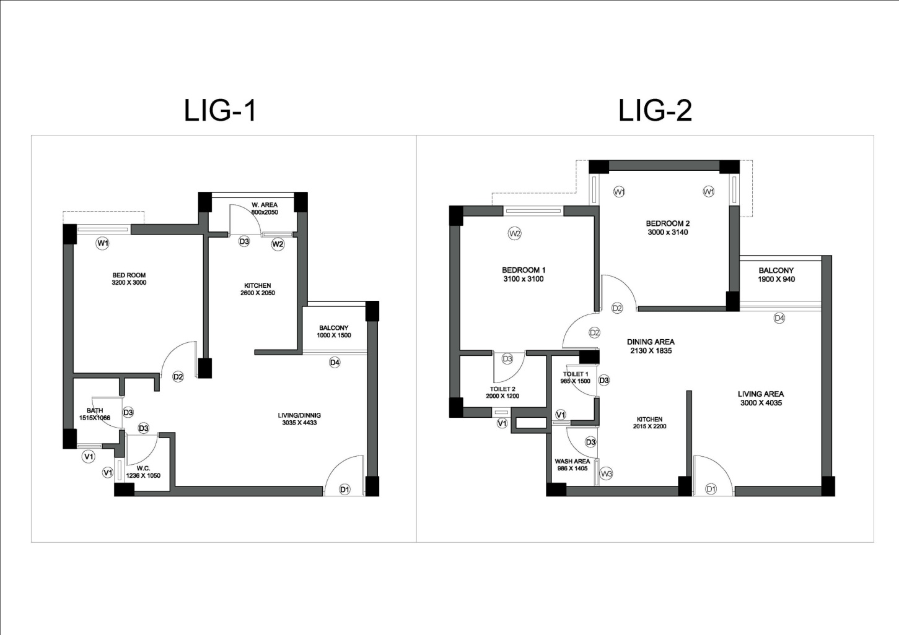
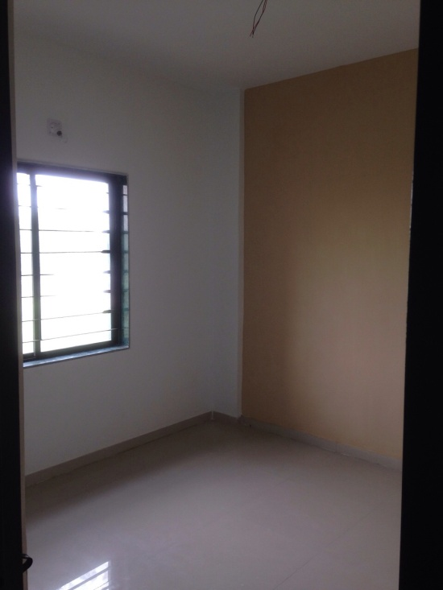
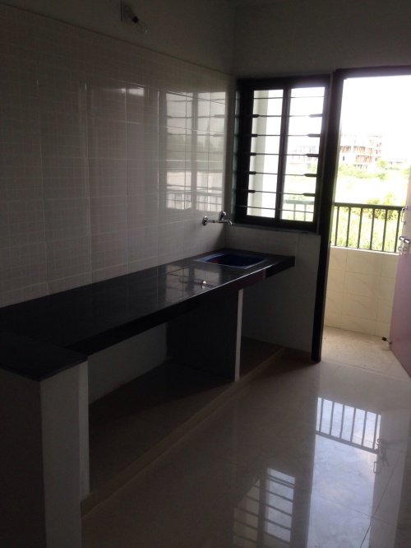
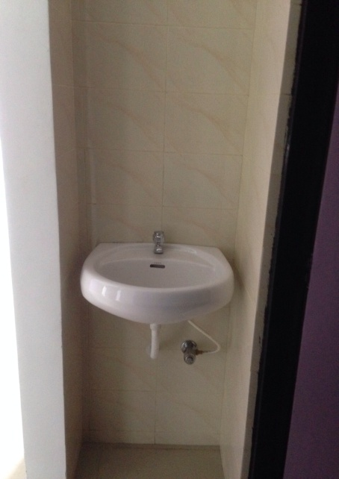
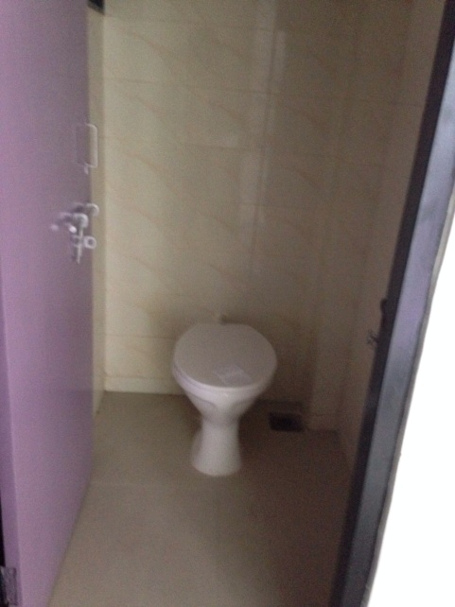
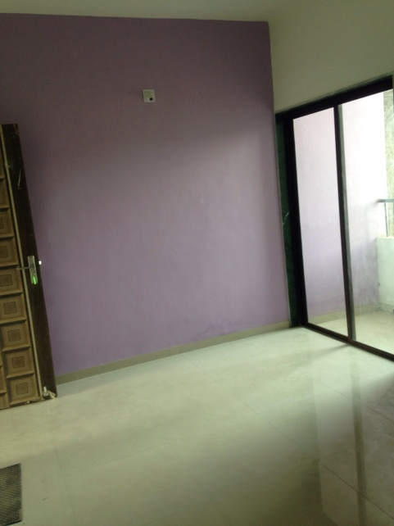
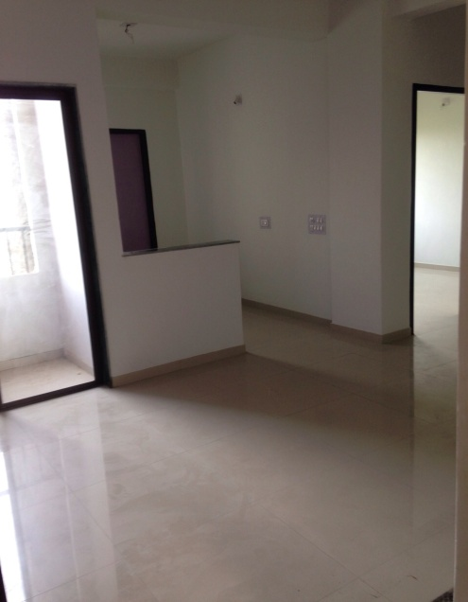
LIG - 1 SEVASI
UNIT PLAN & SAMPLE FLAT PHOTOS OF LIG SCHEME

Slide 14
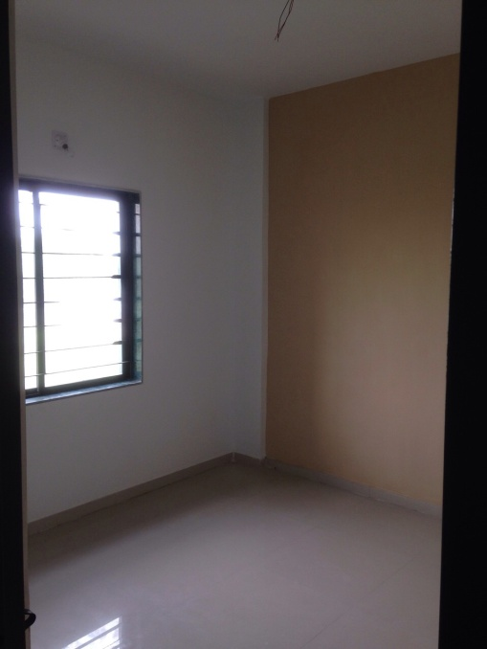
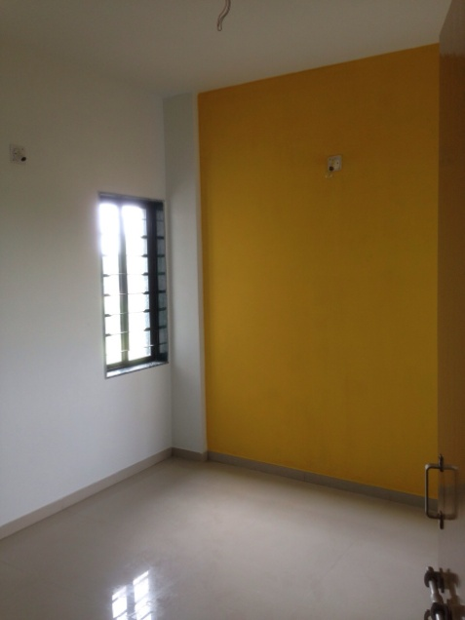
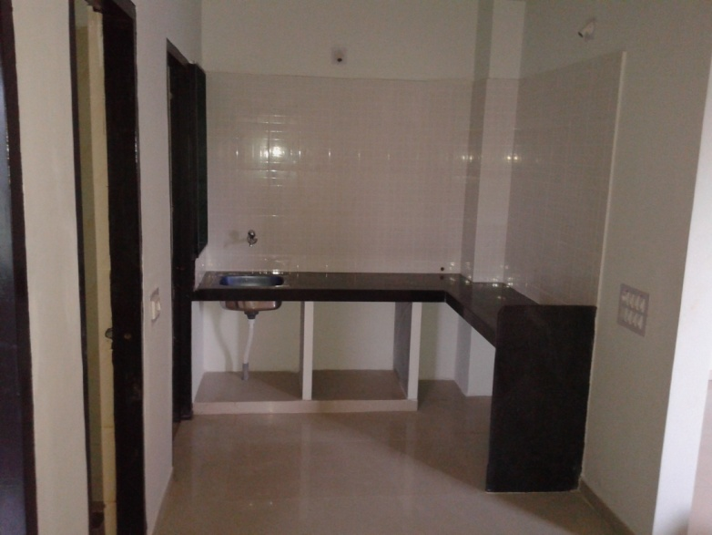
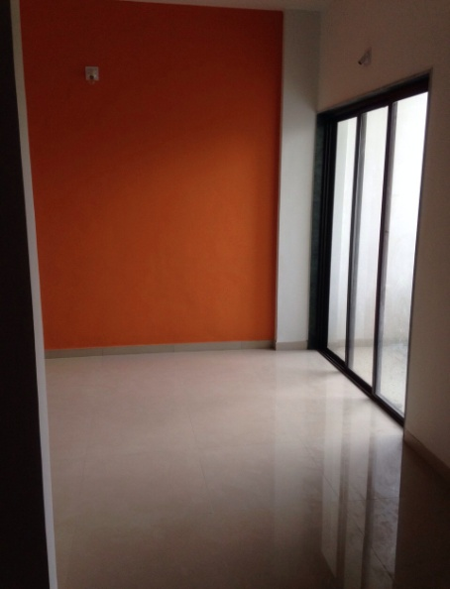
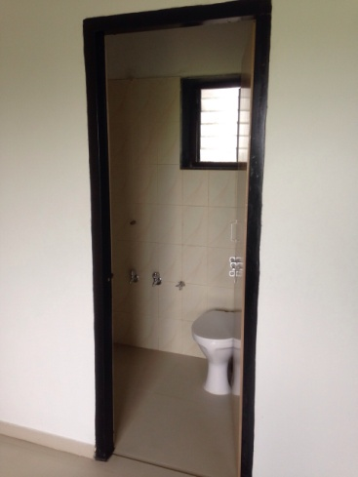
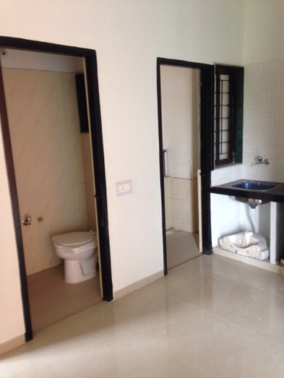
LIG – 2 SEVASI
UNIT PLAN OF LIG SCHEME
14

Slide 15
L I G
VEMALI

Slide 16
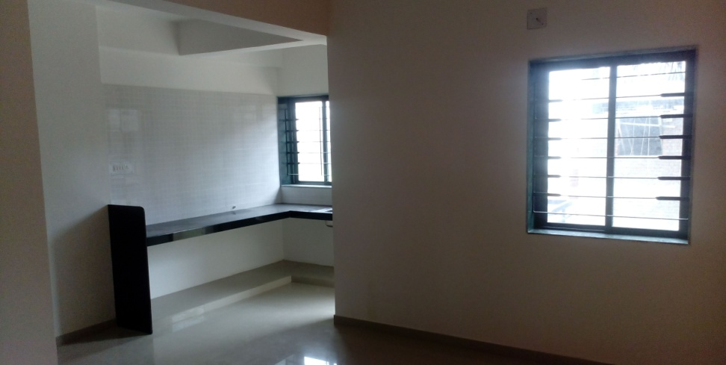
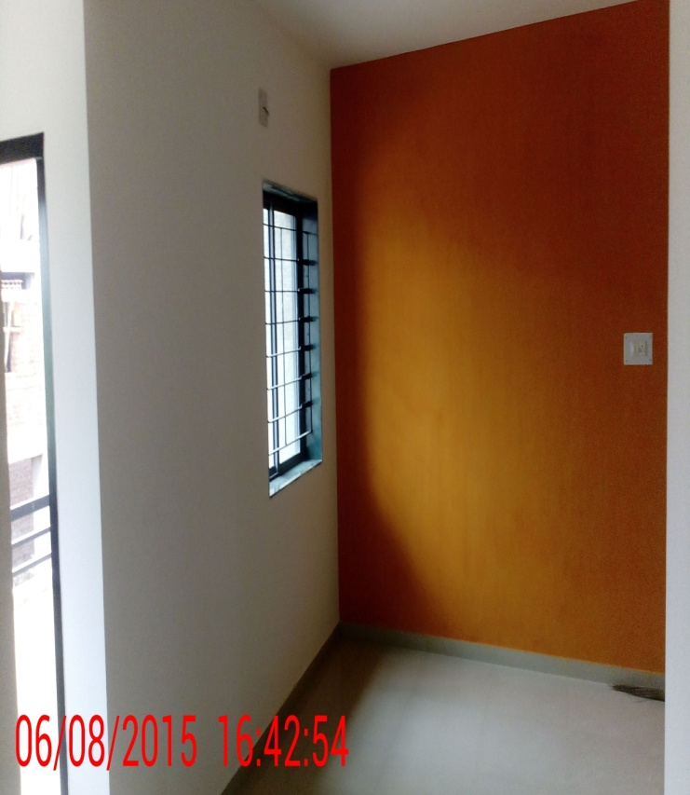
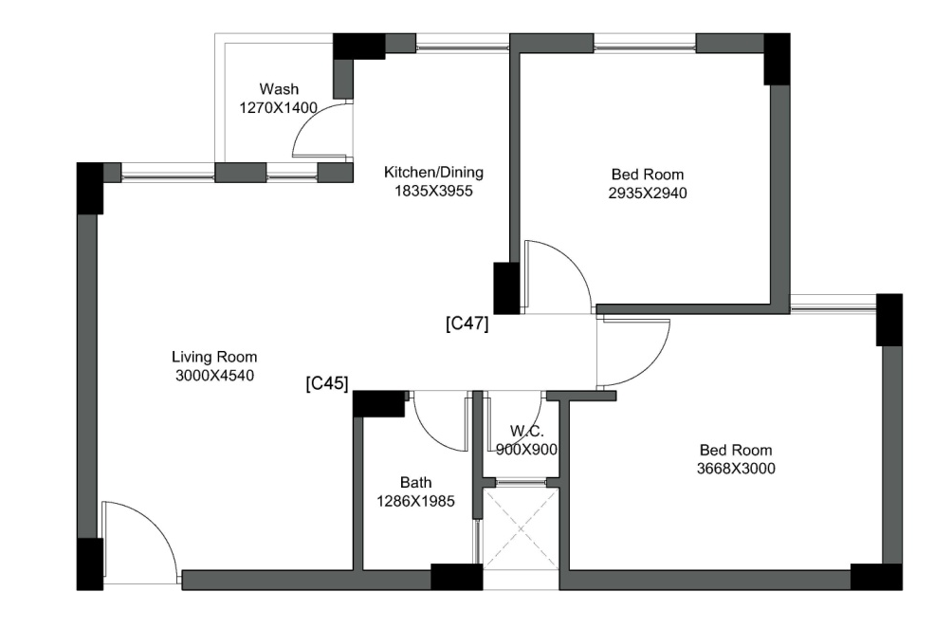
LIG – TYPE - A VEMALI
UNIT PLAN & SAMPLE FLAT PHOTOS OF LIG SCHEME

Slide 17
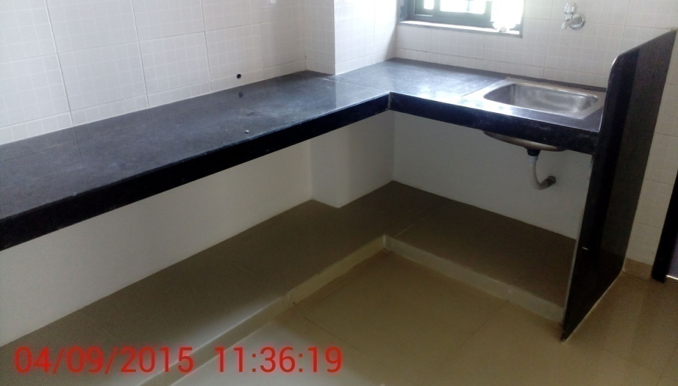
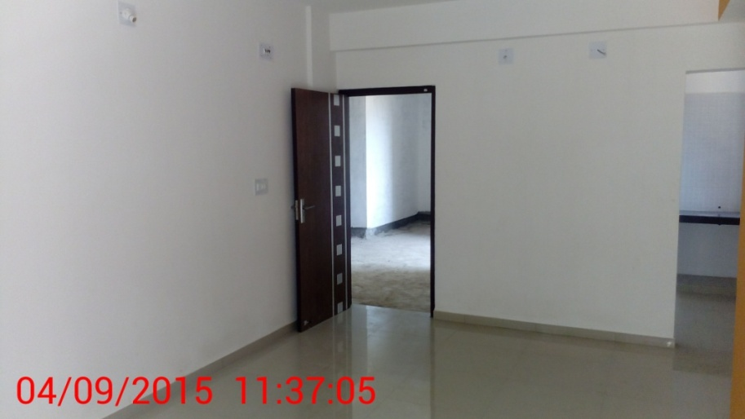
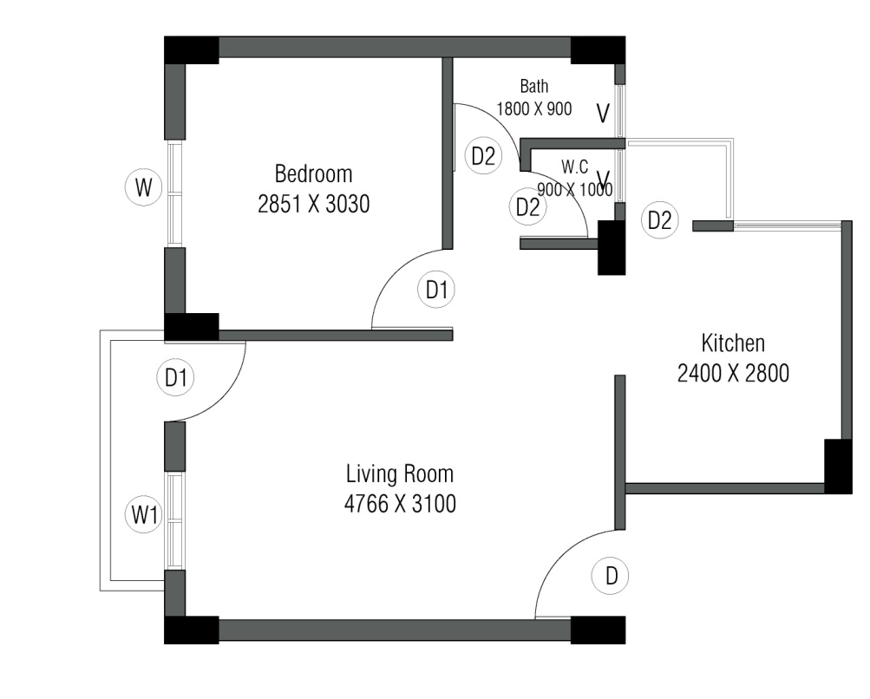
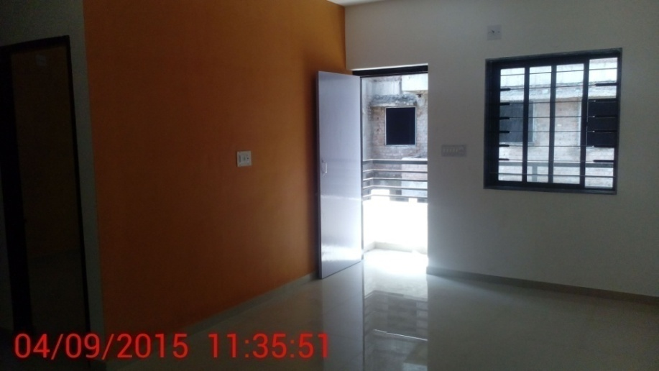
LIG – TYPE - C VEMALI
17
UNIT PLAN & SAMPLE FLAT PHOTOS OF LIG SCHEME

Slide 18
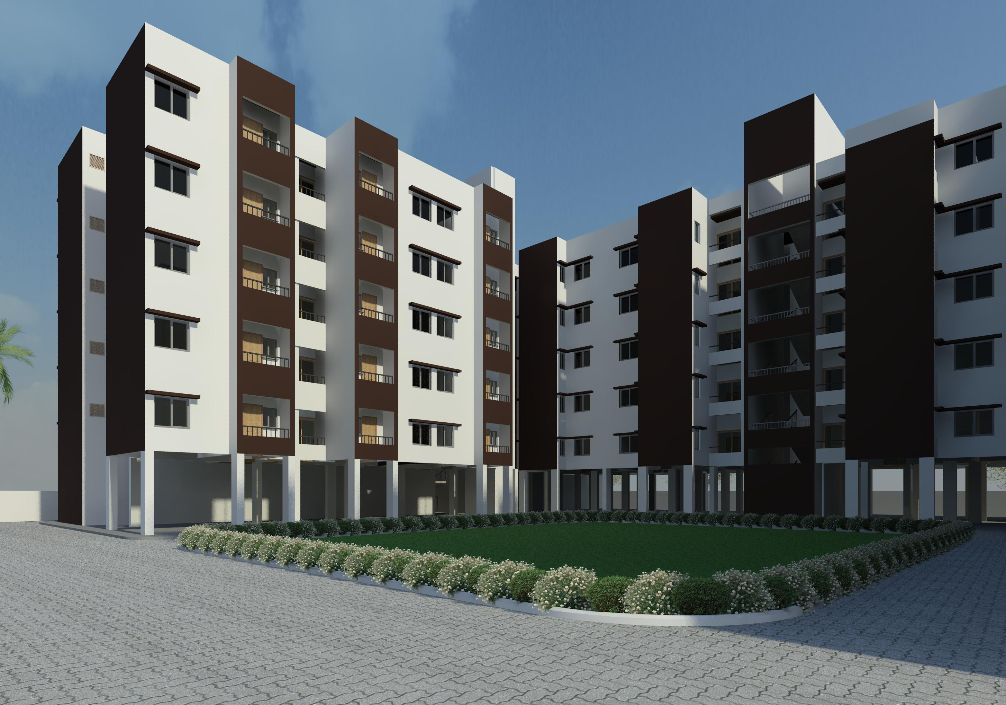
LIG SEVASI
3D VIEWS FOR LIG SCHEME

Slide 19
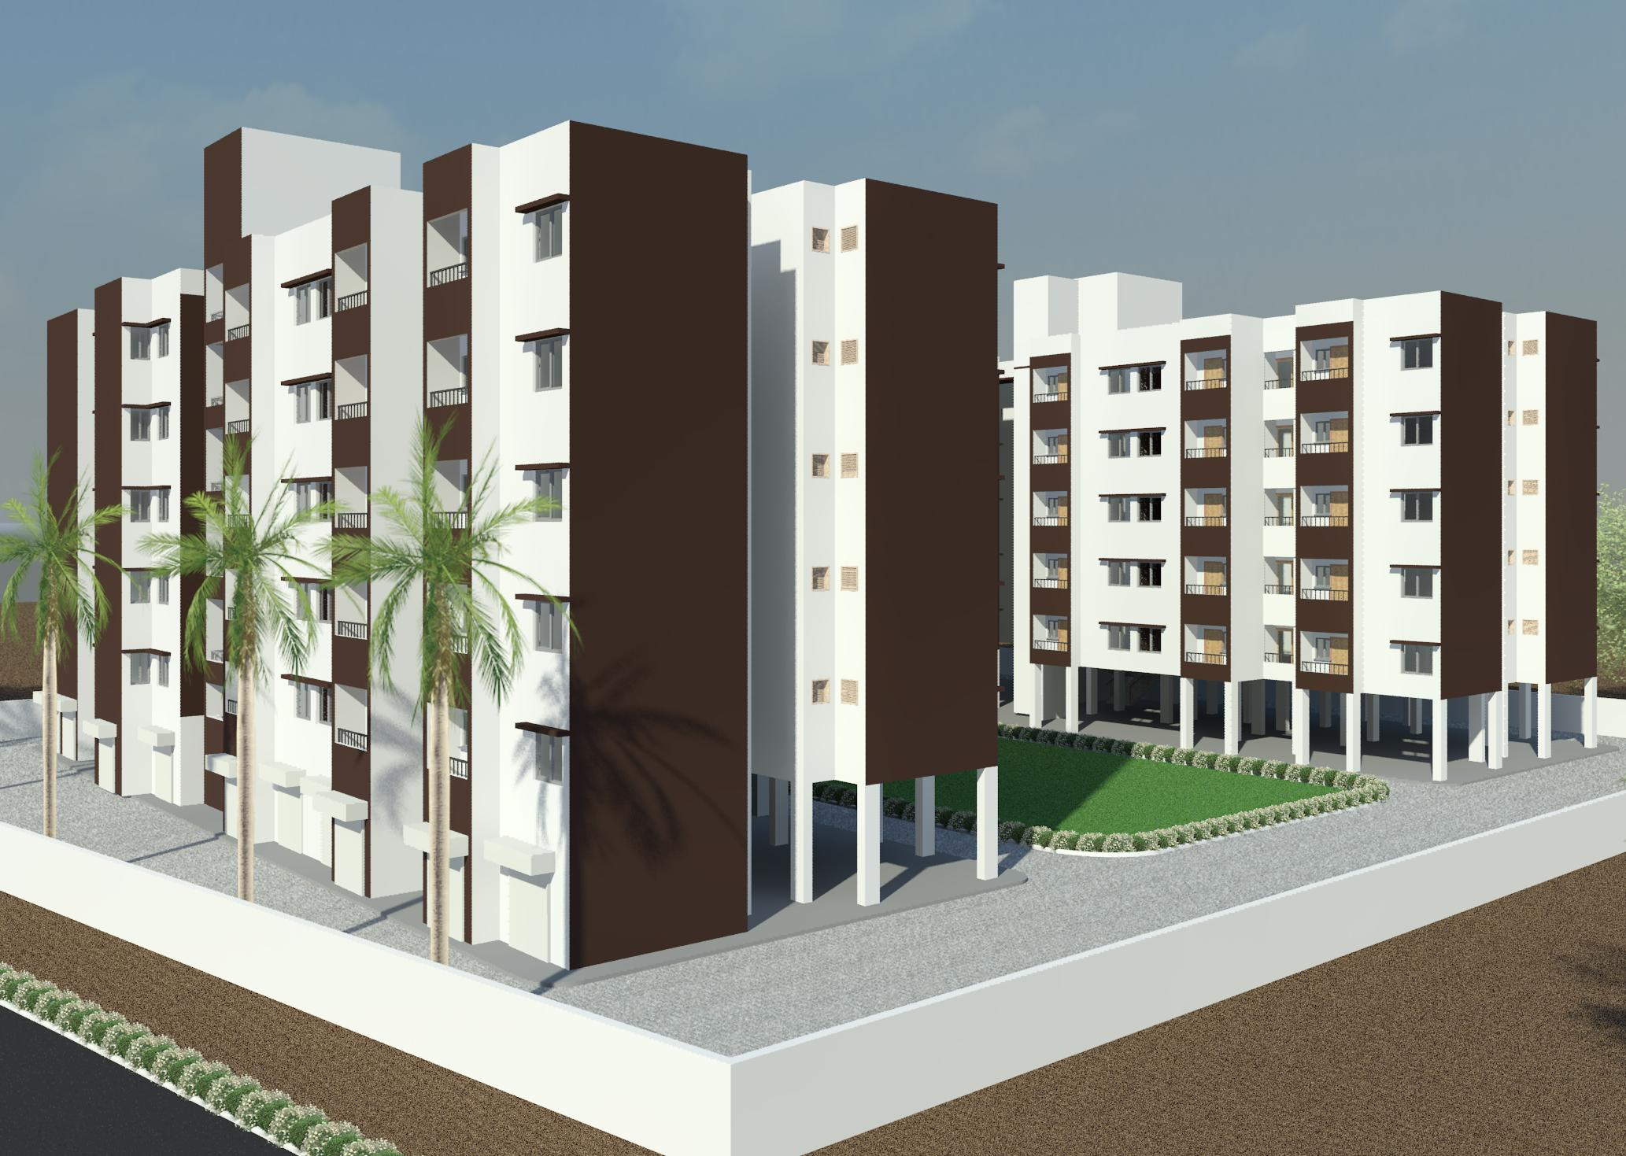
LIG SEVASI
3D VIEWS FOR LIG SCHEME

Slide 20
THANK YOU

